Slide 1
Event Driven Microservice Architecture
Evolveing and scaling your architecture Reliably

Slide 2
The overview
Challenges in doing distributed services
Events how does it work?
CQRS
How does a Microservice look like?
How can we utilize what we have learned to a highly available API?

Slide 3
Me
Martin Clausen
32 Years
Working at Umbraco
8 year’ish years in software development
Incretibly small arms compared to the time i spend in the gym
Diving adventures
Travelling

Slide 4

Disclaimer NO Silver bullet!

Slide 5
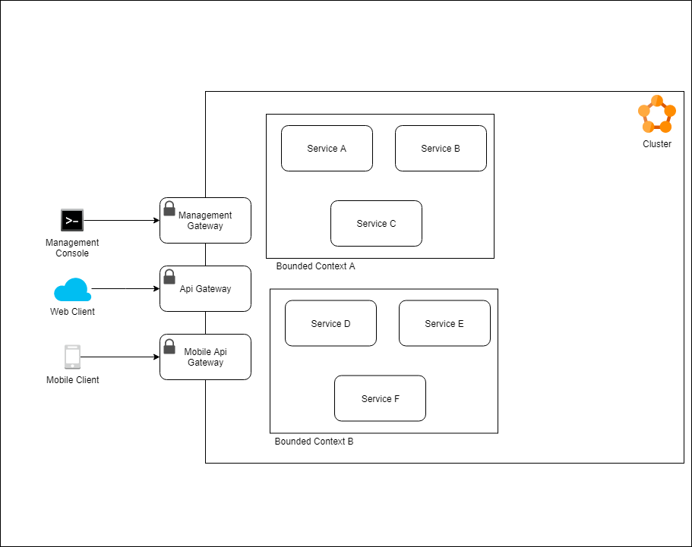
The overview
Notes:
1. Go through the the drawing

Slide 6
Dependency Management
Evolving the architecture
Ever increasing network activity between services
A Mudded landscape where everything is dependent on each other (just like the monolith)
Synchronous communication because its easy
The road to hell is paved with good intentions
Notes:
The promise for easily evolving the architecture through microservices
Latency issues from a user perspective
Email Service example
Mudded domains
Synchonous Communication

Slide 7
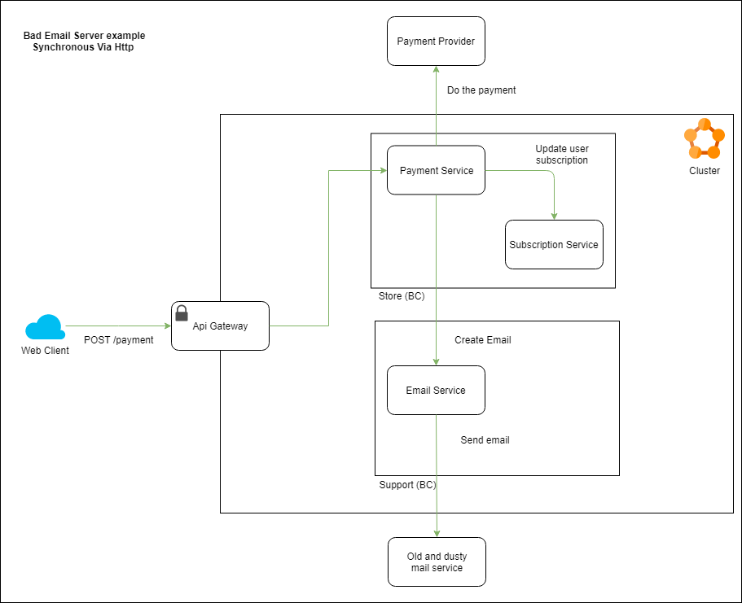

Slide 8
Fallacies of distributed computing
The network is reliable
Latency is zero
Bandwith is infinite
The network is secure
Topology doesnt change
There is one administrator
Transport cost is zero
The network is homogeneous

Slide 10
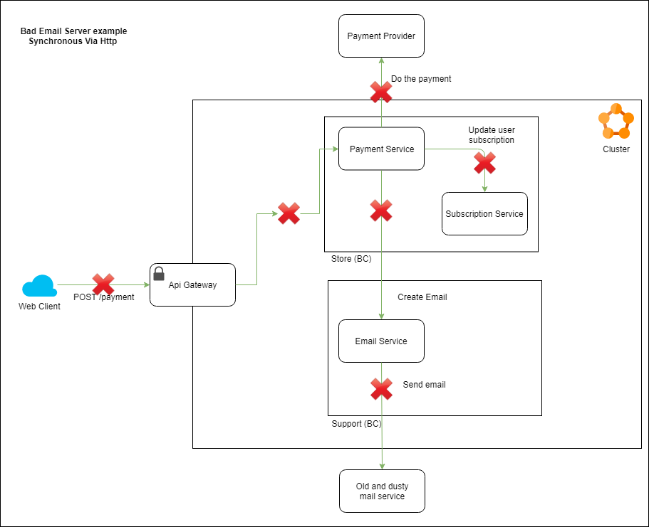

Slide 11
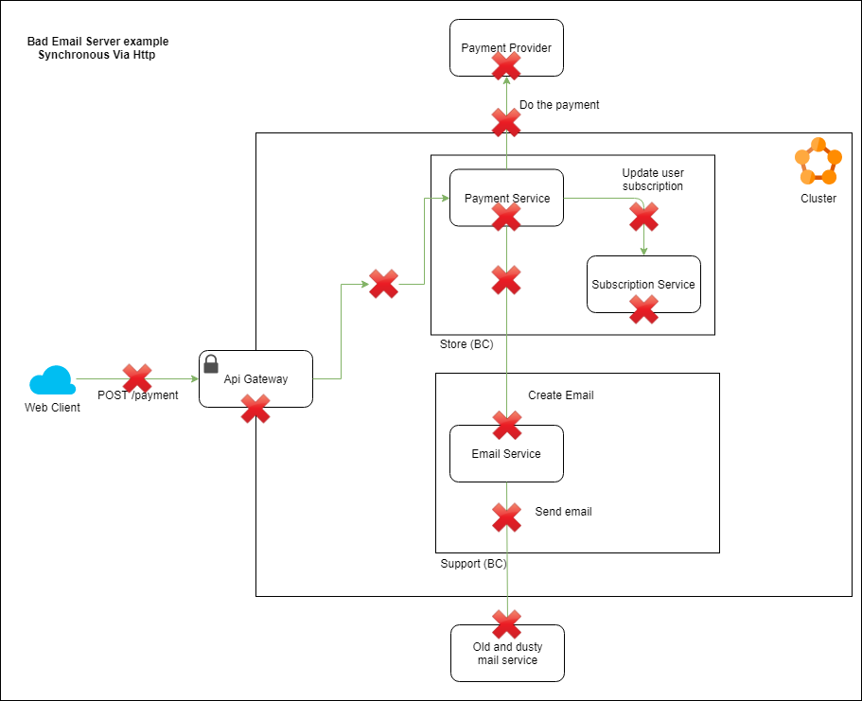

Slide 12
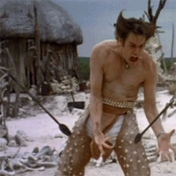
Bird aint gonna fly
Super inconvienent for our customers
Super bad percieved performance (Added latencies, jumping multiple services)
Bad user experience
No way of recovering
Can be hard to find where it all went wrong
Dissapointed accountant who cant pay our company bills

Slide 13


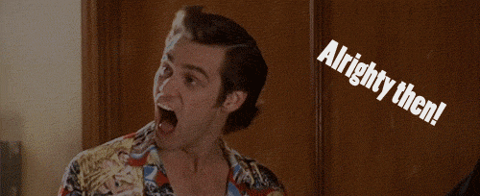
How Can we fix that?

Slide 14

Event Driven archicture
Improved dependency
tree
Better percieved
performance
Why???
Scaleability
Robust Actions
Seamless integration
No Loss of data
Replay Failed
Actions
Notes:
Improved dependency tree
Better percieved performance
More robust handling of individual actions
No Loss of data
Scalability
Replay messages that have been failed (Added error reason)
Seamless integrations

Slide 15
Service bus Vocabulary
Message
Producer / consumer
Publishers / subscribers
Queue
Two types of messages
Events
Commands

Slide 16
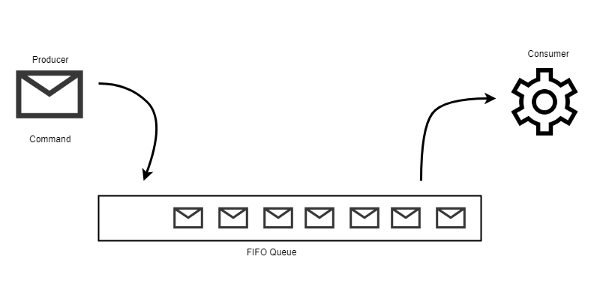
It puts a message on the bus (Commands)
Send command directly to the consumer input queue
One-to-one oneway communication
Commands
Go do something!

Slide 17
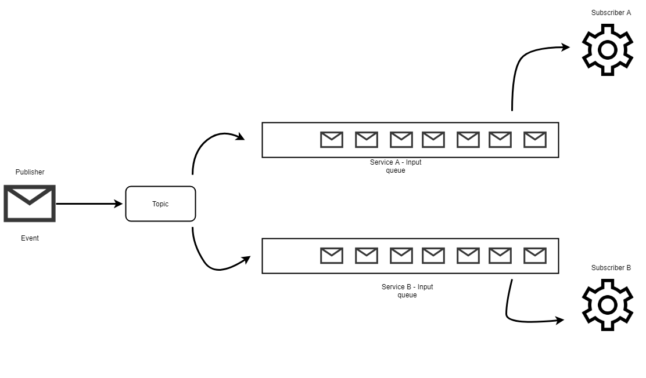
It Puts the message on a Topic (Events)
Send the message to a Topic, that forwards the messages onto all the subscribing input queue
Broadcasting messages – one to many
Events
Stuff has happened in the past

Slide 18
Demo
Commands and events

Slide 19
CQRS
Command Query Responsibility Segregation

Slide 20
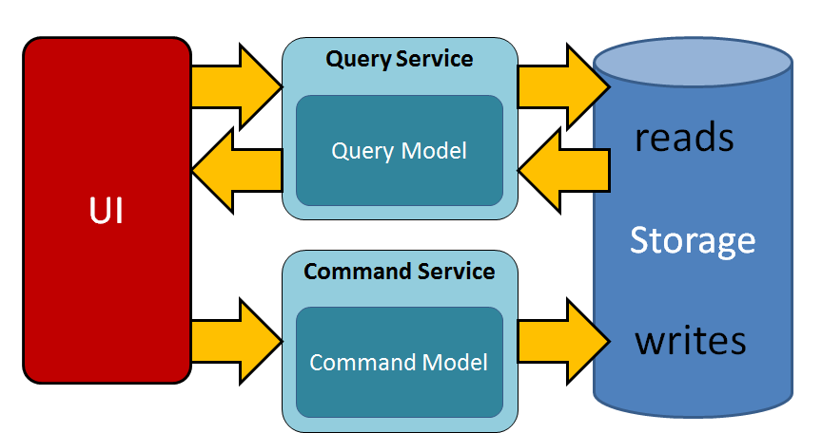
What is it?
Seperates the reads from the writes

Slide 21
Different variations of Cqrs
Single database reads/writes
Two databases, one write model on read model
Event Sourcing

Slide 22
Commands Via ServiceBus
Has side effects
Modifies the state
Does not return a result

Slide 23
Quiries via http
Answers requests
Does not modify the status
Does return a value

Slide 24
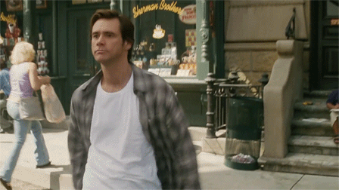
Hit Save!
We are going to need this later!

Slide 25

Microservices
A service should be small
Centered around a domain/aggregate root as defined in Domain Driven Design
A variation of a hexagonal architecture
Ports and adaptors
Clean Architecure
Etc

Slide 26
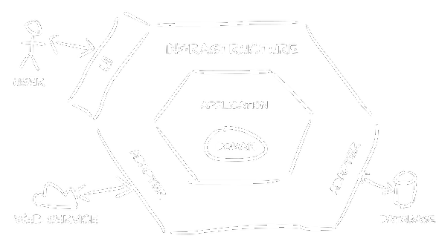
Hexagonal Service Architecture

Slide 27
Each DOMAIN has two services
What is this mad man talking about?

Slide 28
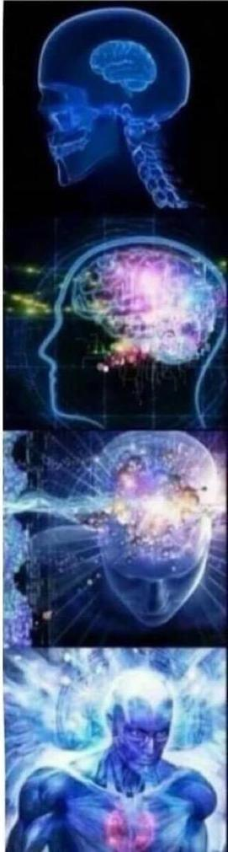
Why?
Complete seperation of reads/writes
Easy data migration – Events and syncronization are not affecting the users
Self balancing services – Updating denormalized data in the background
Reliable performance

Slide 29

The real magic
Individual scaleable components

Slide 30
Demo Time
Take a look on the microservice

Slide 31
Original problem Managing our dependencies

Slide 32
Communication
No Chaining Service to service http calls
Max 1 http call from the api service
Only call out to 1 domain / service
Challenges
Normalized data structures
Notes:
People will go to great lengths for data normalization
Denormailized data: Facebook friend list sample

Slide 33
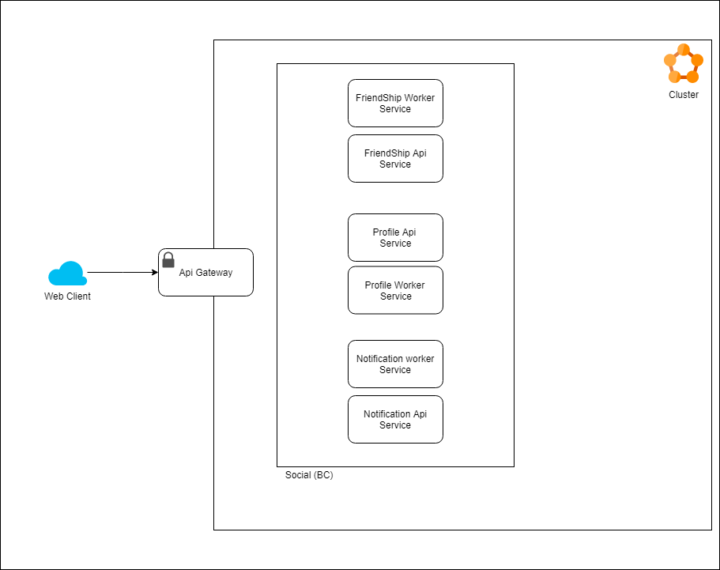
Demo Introduction

Slide 34
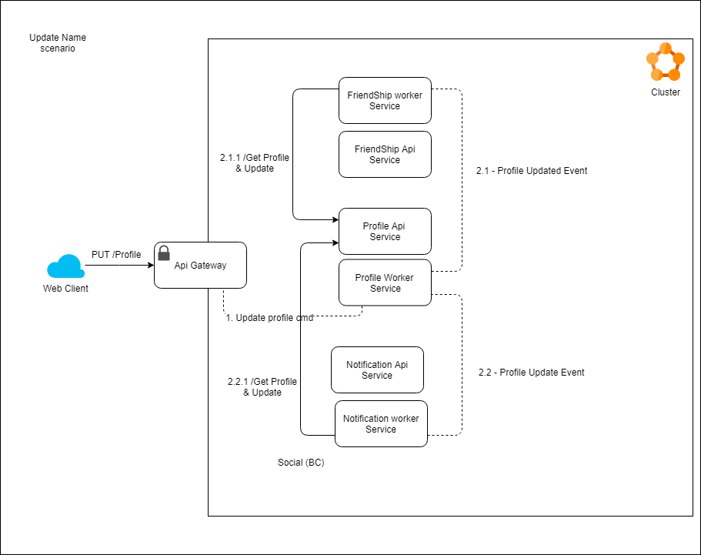
Update Name

Slide 35
Demo
Keeping Denormalized data up-to-date

Slide 36
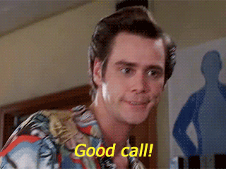
Conclusion
Wins
High Availability API
Low latency
Clear seperation of concerns
Low coupling between Services
Easily evolving architecture
The challenge - Eventual consistency
Remedy with Technologies such as SignalR
Meaningful UI
Queue monitoring and alerts
Compensating events

Slide 37
You might want to use
Service Orchestrators
Service templating
CI/CD Pipelines
Have fun, and reach out!

Slide 38


